Slide 1

S225 HIT140 – Foundations of Data Science
Data Analysis
Assignment 2
Group 2

Slide 2
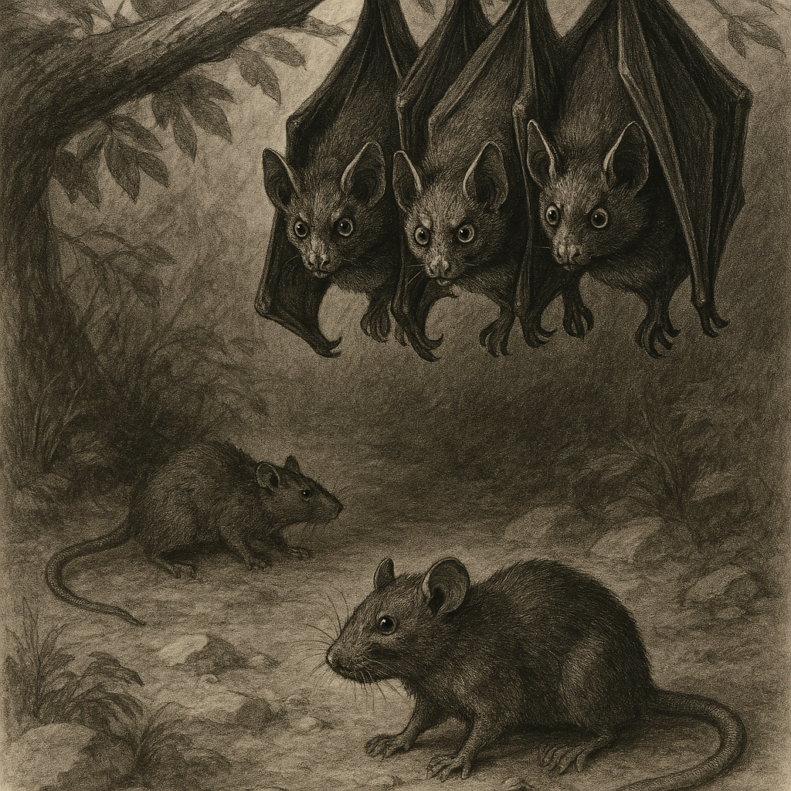
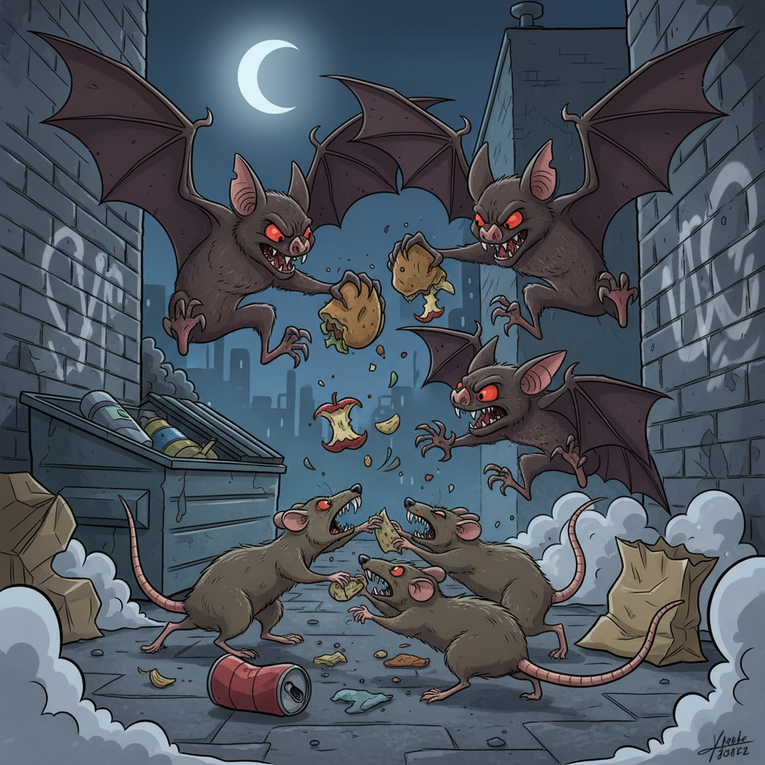
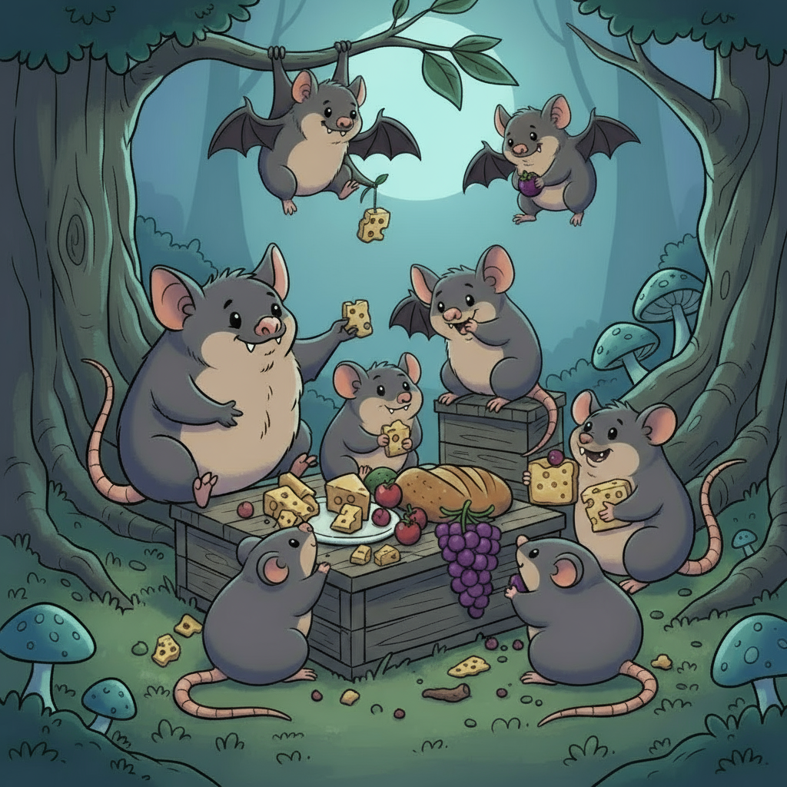
Alternative Hypothesis
Bats perceive rats as potential predators. Increased vigilance seen in bats when rats are around during foraging on the food platform
Do bats perceive rats not just as competitors for food but also as potential predators?

Slide 3
Alternative Hypothesis
Bats perceive rats as potential predators. Increased vigilance seen in bats when rats are around during foraging on the food platform
Do bats perceive rats not just as competitors for food but also as potential predators?

Slide 4
Background on Datasets
Data set 1 is through

